Slide 1
Free Your On-Premises Data!
Sam Basu | @samidip
Developer Advocate | Telerik
Major foodie | Into gadgets, web, mobile

Slide 2


What’s on the plate
“
Keep your Data in-house.
Expose through Services.
Secure & X-Plat.
Your Data Everywhere!
Cloud Data Myth
Need for Services
Telerik Data Connectors
Azure Hybrid Connections
Security & Other concerns
Free your Data

Slide 3

Why use the Cloud?

Slide 4
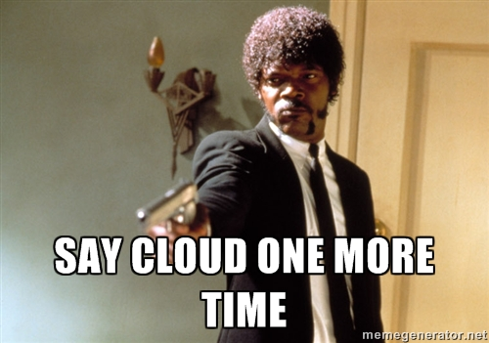
Are you all in?

Slide 5
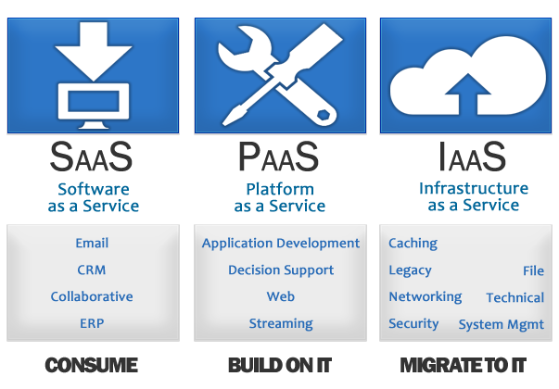
Cloud Computing Offerings
Always evaluate your needs | Compare Providers

Slide 6
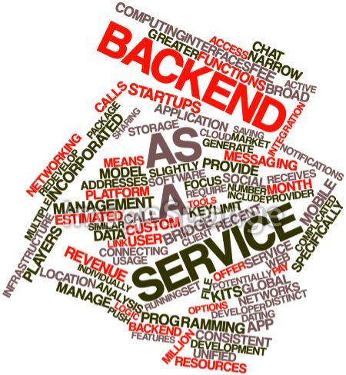

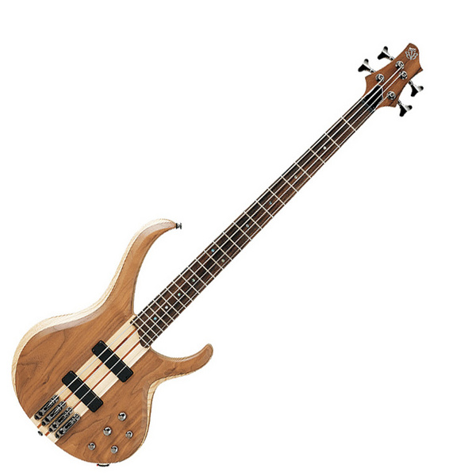
Say BaaS!
You could mix & match | Hybrid stories | Data services

Slide 7
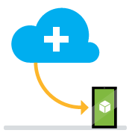


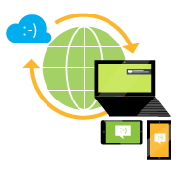

BaaS Benefits
Easily add Cloud Backend for your apps
Reach every user on any Platform
Cross-Platform Push Notifications
Social User Authentication
Scale on demand with global availability & reach
RESTful Services over Relational/Non-Relational Data
Cloud Code (.NET/NodeJS)

Slide 8
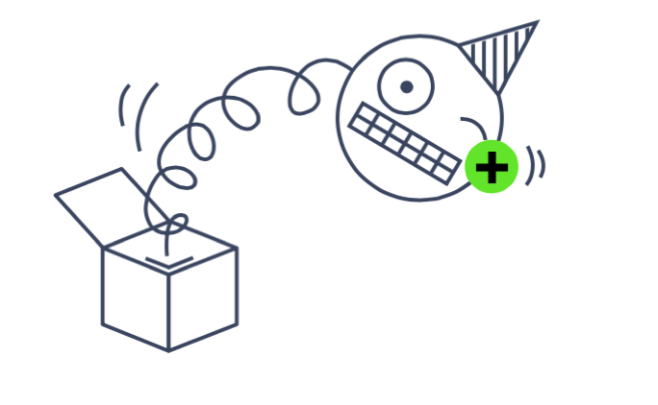

Everyone keeps talking about the Cloud …
I have Enterprise Data, damn it | I can’t just move to the Cloud

Slide 9
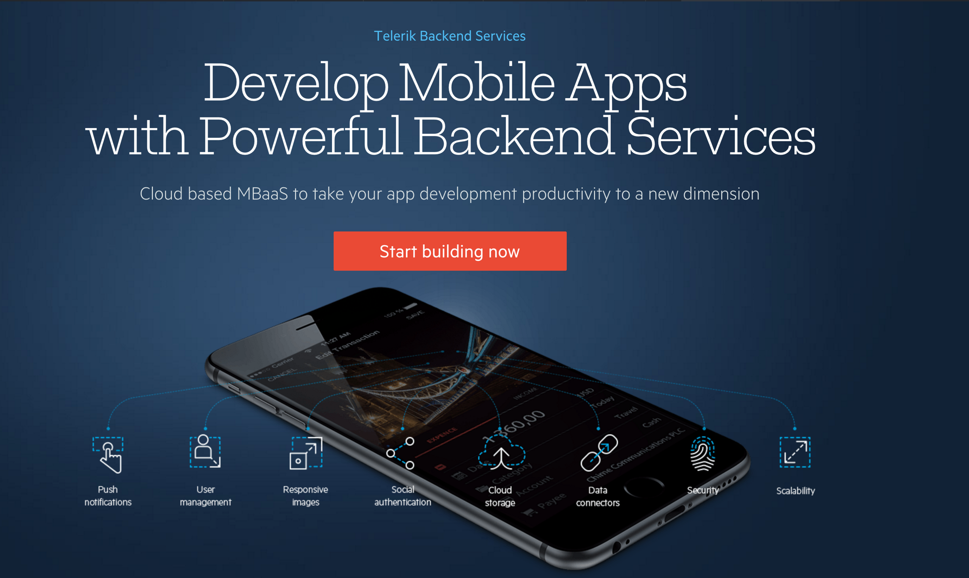

Slide 10
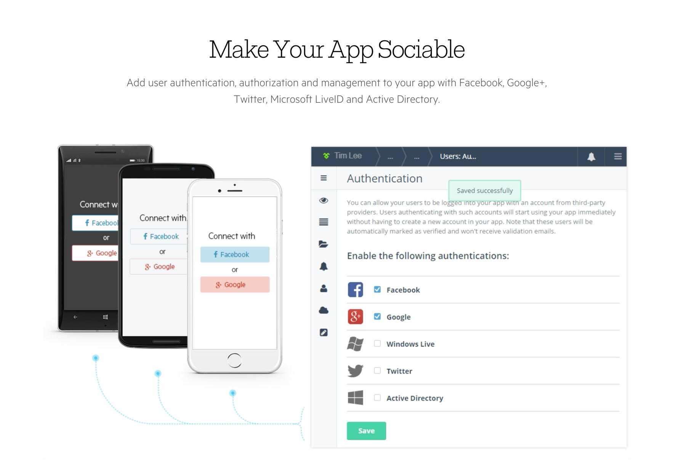

Slide 11
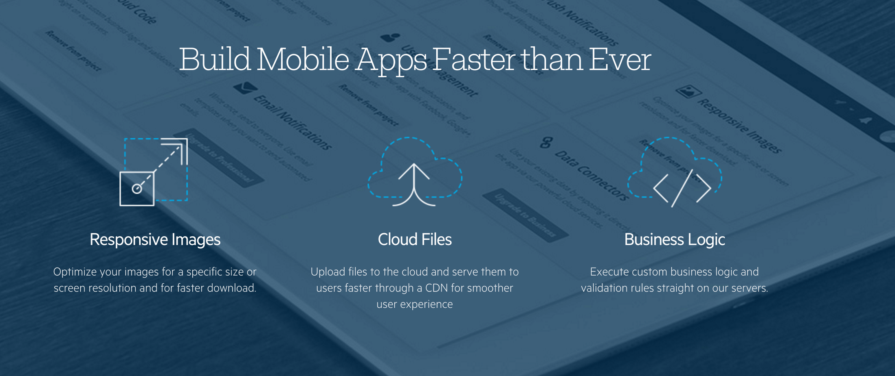

Slide 12
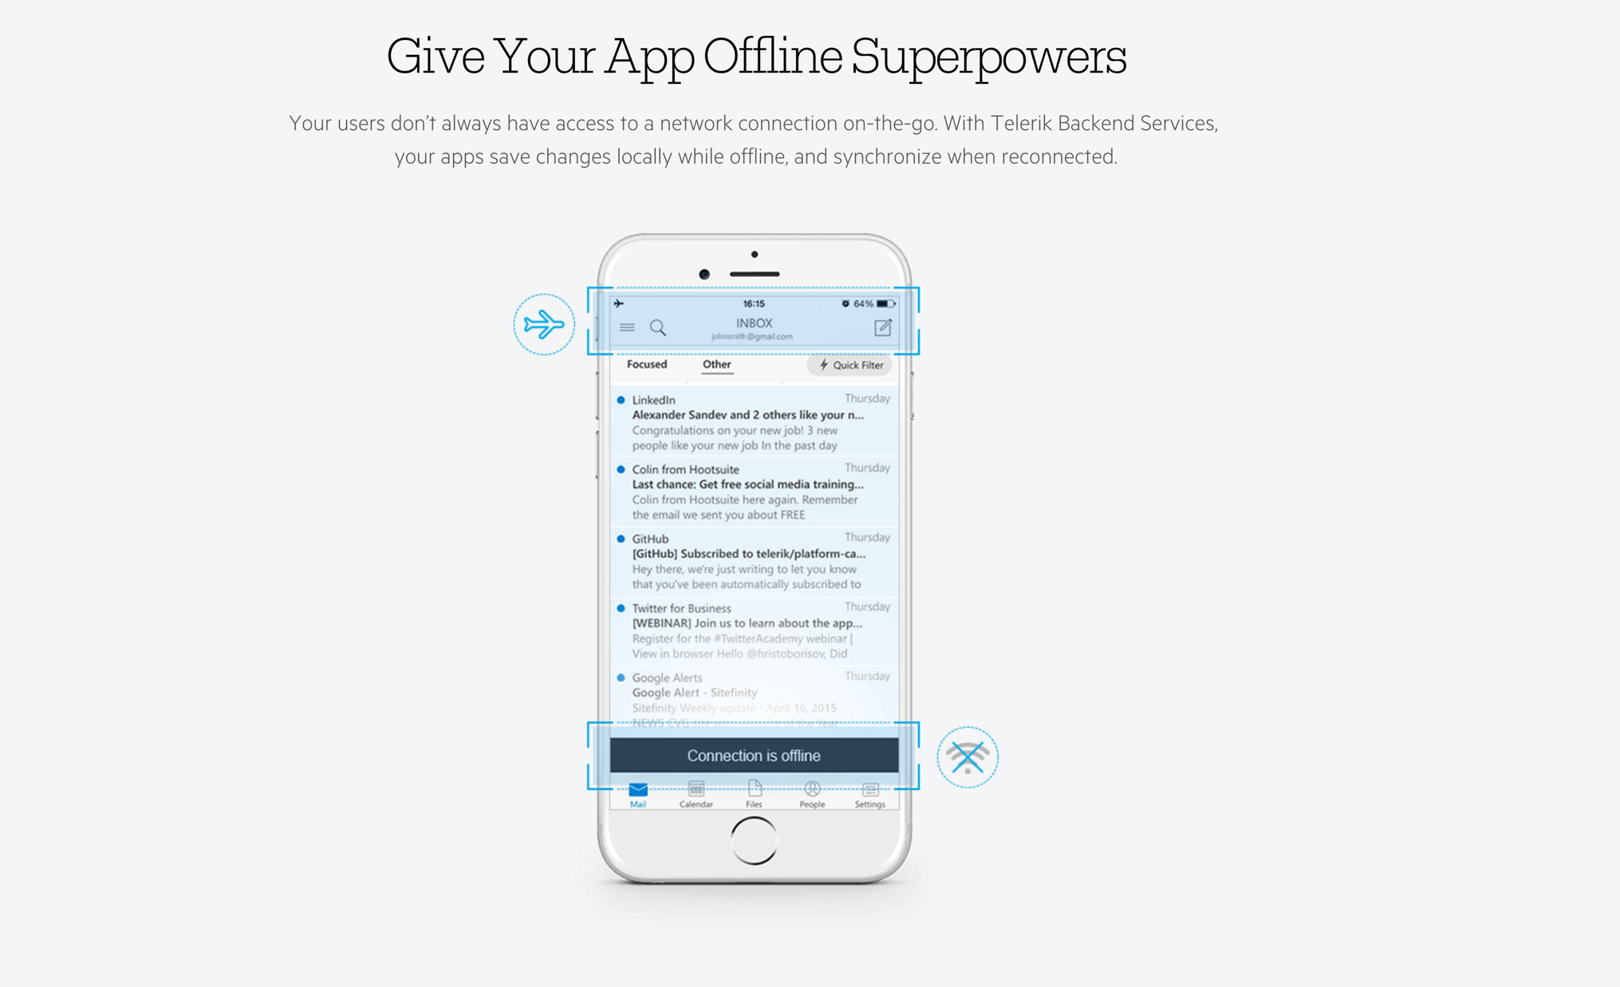

Slide 13
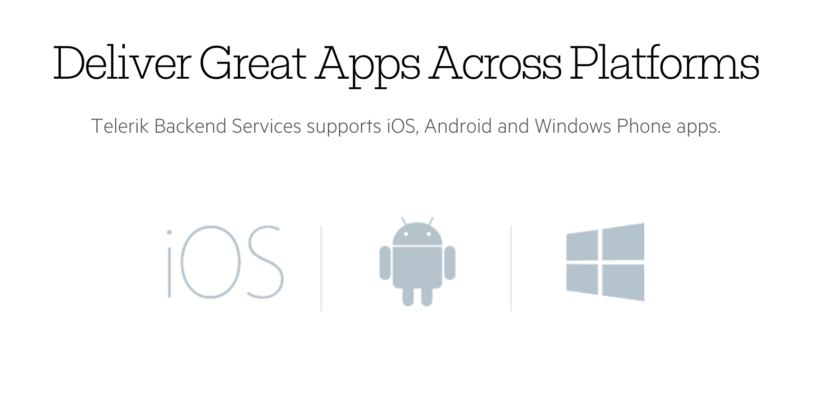

Slide 14
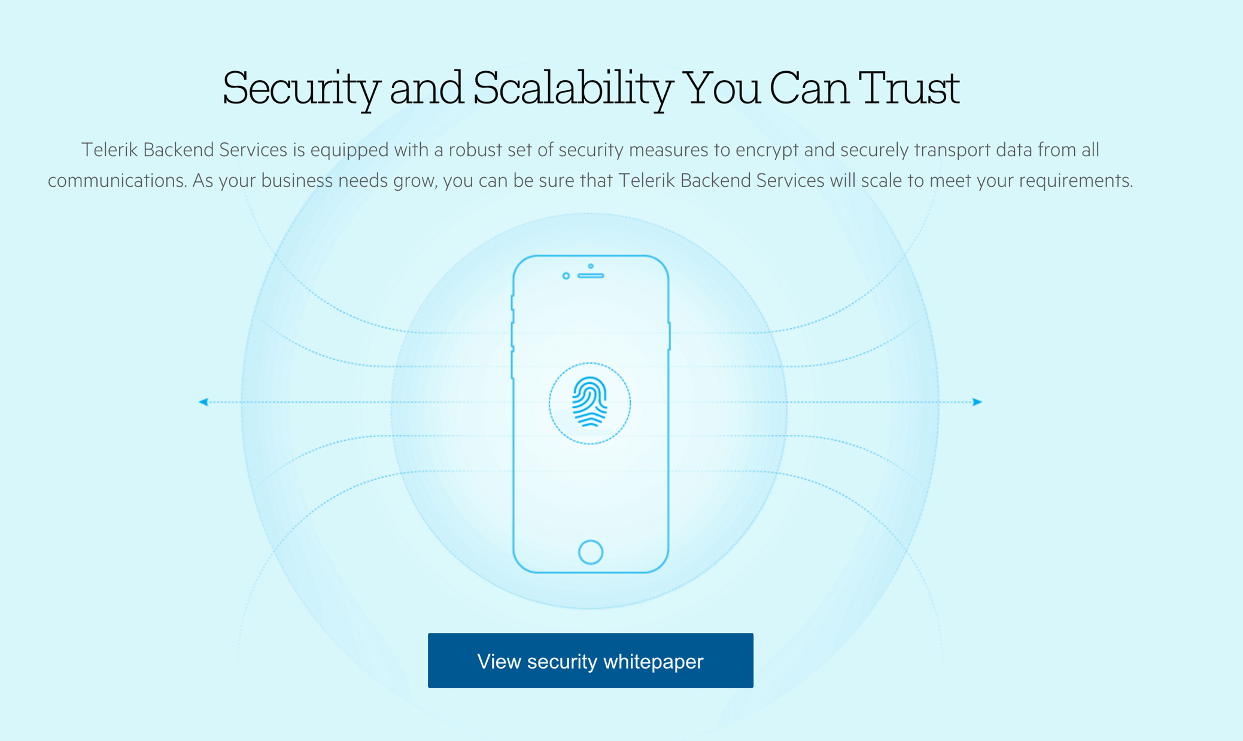

Slide 15
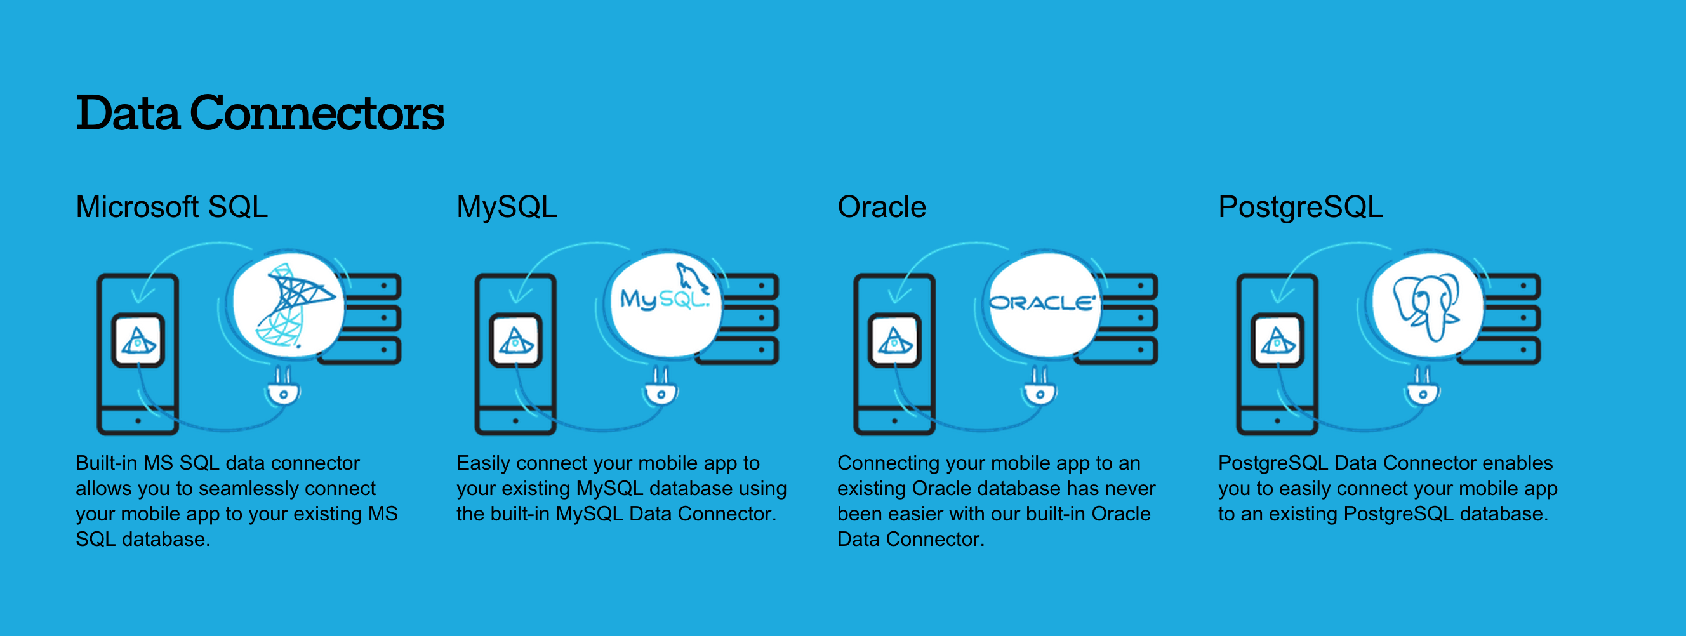
Data Connectors in Backend Services!
Did someone mention SalesForce? We got you covered!

Slide 16

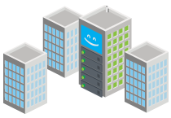
I like big Demos .. I cannot lie!
Let’s free your On-Premises Data …

Slide 17
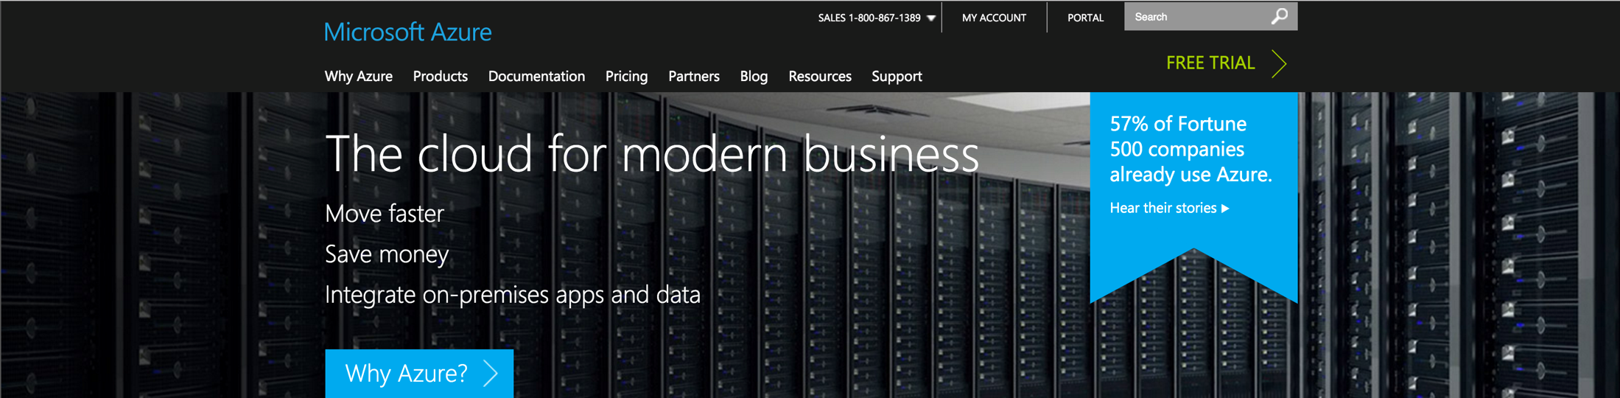
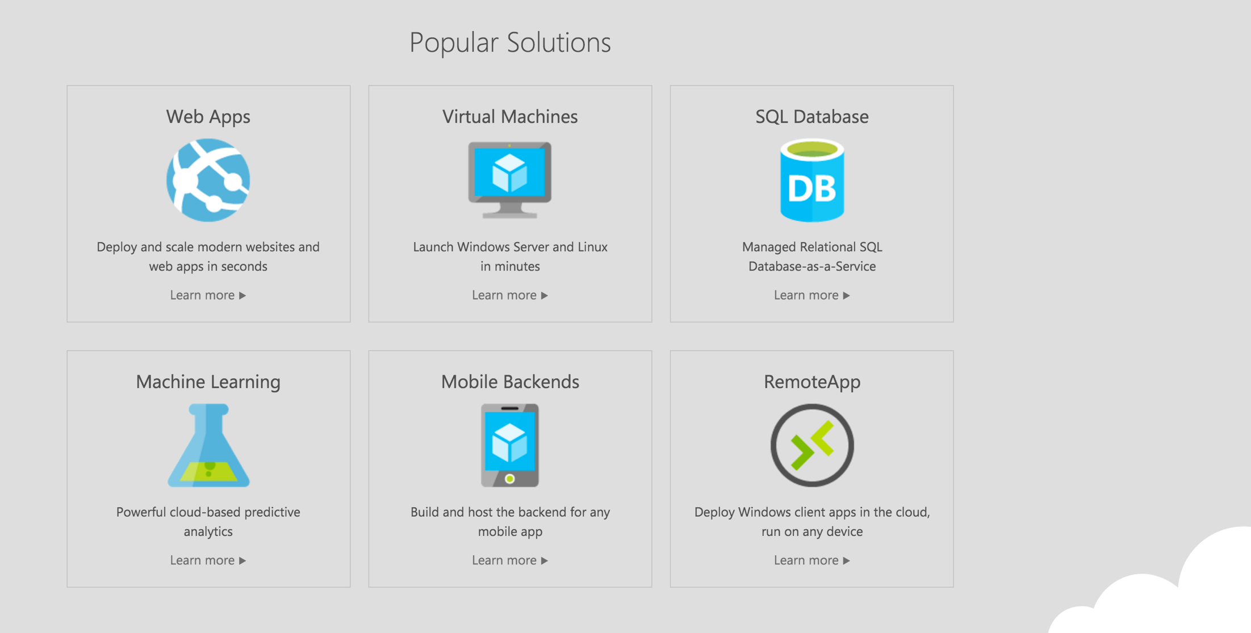

Slide 18
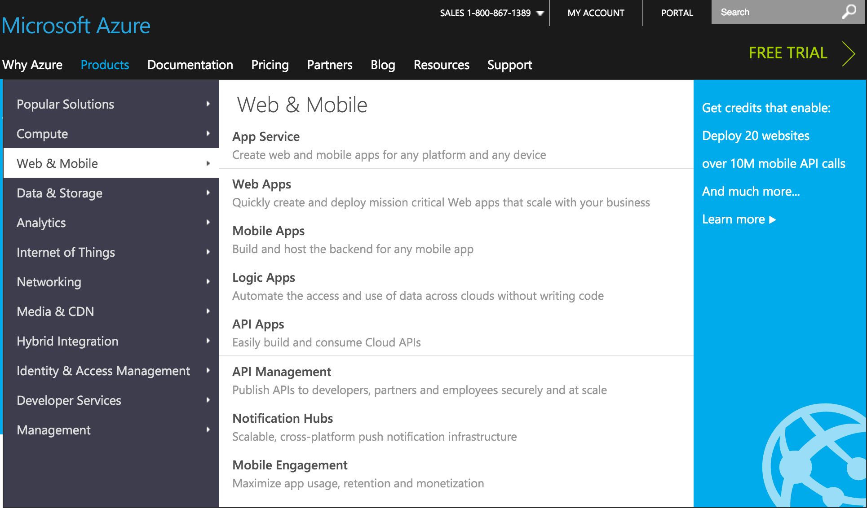

Slide 19
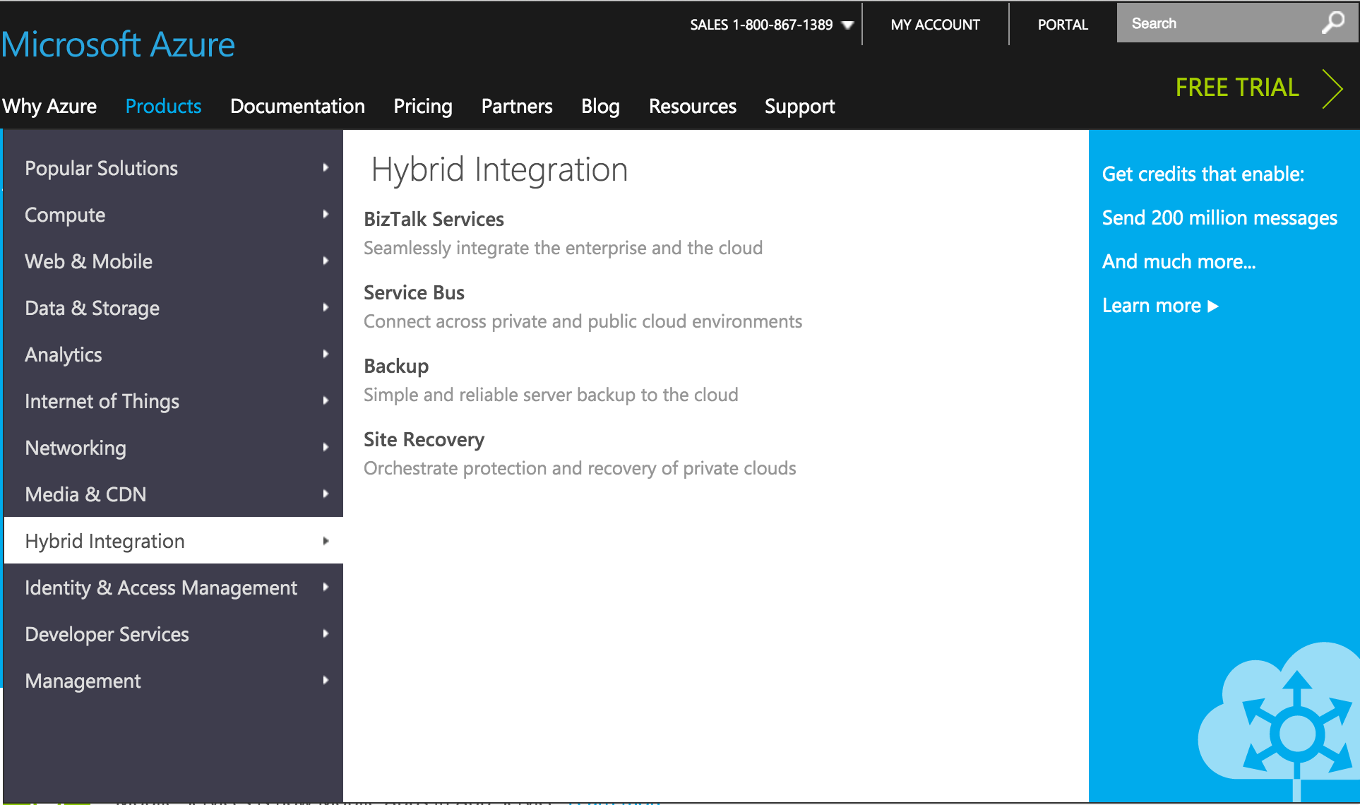

Slide 20
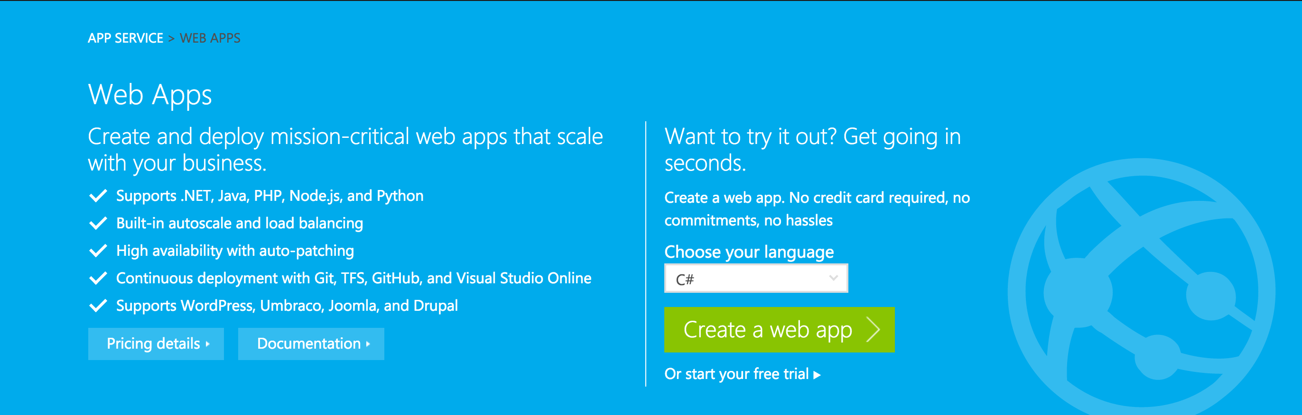
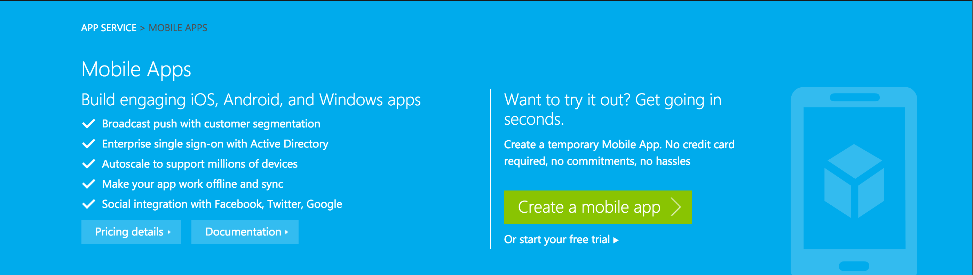

Slide 22
Riskier Demos … Why Not!
Let’s Connect to On-Premises Data …

Slide 23

That’s it … You’re moving my cheese!

Slide 24

I have some Concerns though ...
Security
Stored Procedures
Performance
Concurrency

Slide 25

Q/A Time!
Thank You Very Much!
@samidip

